Slide 1
Mountain Pacific Wyoming’s Quality Improvement Organization and Quality Improvement Network
Jill Hult, RN, MSAS, NHA, CIC
Callie Perkins, RN, BSN
Larissa Skinner, BSW
Jennifer Stewart, MSHSA
May 7, 2024

Slide 2
Mountain Pacific’s Region of Service
Hawaii
Montana
Saipan
Alaska
Guam
American Samoa
Wyoming
Notes:
Recruitment and metrics are rolled up int

Slide 3
Centers for Medicaid & Medicare Services (CMS) Initiatives
Mountain Pacific
Office of Healthcare Licensing
and Surveys
Non-regulatory and consultative – Provider participation is voluntary
Funded by CMS
Services provided for free to providers
Focused on improving patient care
Focus areas:
Infection prevention and control assistance (COVID-19 outbreaks, vaccine education and assistance, National Healthcare Safety Network [NHSN] reporting assistance)
Decrease opioid use and misuse
Reduce emergency department use and 30-day readmissions
Decrease adverse drug events and hospitalizations due to Clostridioides difficile (C. diff) or other infections
Chronic disease management within communities
Assistance with emergency preparedness
Regulatory – Ensure nursing homes are following CMS regulations, outlined at 42 CFR paragraph 483, subpart B. Survey process consists of observation, interview and record review.
Types of surveys:
Traditional (standard)
Initial Recertification
Revisit survey Compliant
Life safety
Focused infection control
Emergency preparedness
Clinical laboratory improvement amendments (CLIA)

Slide 4
Current Initiatives
(End November 2024)

Slide 5
Metric Performance: Comparison of Wyoming Nursing Homes (NH) Against the Mountain Pacific Region and Nation

Slide 6
What is relative improvement rate (RIR)?
Allows for comparisons of metric performance over time and between different populations. In this case, the different populations are defined by geographic region: Wyoming, Mountain Pacific Region (Alaska, Hawaii and Pacific Territories, Montana and Wyoming) and National
Measures how Mountain Pacific interventions affected metrics from a baseline measurement period
Metrics are also influenced by national, state and local trends that are out of Mountain Pacific’s control (e.g., vaccine hesitancy)

Slide 7
Adverse Drug Events and Opioids
Decrease opioid adverse drug events (ADEs), including deaths, for high-risk residents in NHs by 7%.

Slide 8
RIR of emergency department (ED), observational stay (OBS) and inpatient opioid adverse drug events among home long-stay Medicare residents with opioid high-risk medications.
Wyoming NHs outperform other NHs in the Mountain Pacific region but trail the nation.

Slide 9
RIR of nursing home short stays with an ED, OBS or inpatient opioid ADE among Medicare residents with opioid high-risk medications.
Wyoming is not doing well here, but the current numerator is <10. A prime example of how a single digit number of beneficiaries can swing the RIR by a large amount.

Slide 10
Patient Safety
Hospitalizations due to C. diff decrease by 10% and ADEs in NHs decrease by 13%
Decrease in hospitalizations r/t facility acquired infections in NHs by 30% (COVID, sepsis, UTI, pneumonia)

Slide 11
RIR of inpatient admissions due to C. diff infection per 10 million NH among long-stay Medicare residents.
Wyoming and the Mountain Pacific region outperform the nation in reducing and eliminating C. diff infections in NHs.

Slide 12
RIR of NH short stays with an inpatient admission due to C. diff infection per 100,000 among Medicare residents.
The work Mountain Pacific is doing for C. diff prevention, not only in Wyoming but throughout the region, is contributing to positive improvement at the national level.

Slide 13
RIR of ED, OBs and inpatient anticoagulant, antidiabetic, or opioid ADEs among 100,000 NH long-stay Medicare resident with filled prescription(s).
Wyoming leads the charge in reducing ED, OBs and inpatient admissions among NH residents.

Slide 14
RIR of NH short stays with an ED, OBS or inpatient anticoagulants, antidiabetic or opioid ADE per 1,000 stays among Medicare residents with filled prescription.
Wyoming leads the charge in reducing ED, OBs and inpatient admissions among NH residents.

Slide 15
RIR of inpatient admissions due to COVID-19, pneumonia, sepsis or urinary tract infection (UTI) per 100,000 NH long-stay Medicare residents.
Wyoming currently shows significantly lower admission rates for COVID, pneumonia, sepsis and UTIs.

Slide 16
RIR percentage of NH short stays by Medicare residents having an inpatient admission due to COVID-19, pneumonia, sepsis or UTI.
Wyoming outpaces the nation and rest of the Mountain Pacific region in reducing admissions among short stay residents.

Slide 17
Decrease in preventable ED visits by 14% for LTC residents. Decrease in 30-day readmission to hospital by 9% for LTC residents.
Care Coordination

Slide 18
RIR percentage of NH short stays by Medicare residents having a potentially preventable ED visit within 30 days after inpatient discharge.
The entire nation is experiencing an uptick in preventable ED visits. Unfortunately, short stay residents in Wyoming are experiencing a disproportionate increase in preventable ED visits.

Slide 19
RIR percentage of NH long-stay residents who are having a potentially preventable ED visit within 30 days after inpatient discharge.
The entire nation is experiencing an uptick in preventable ED visits. Unfortunately, long stay residents in Wyoming are experiencing a disproportionate increase in preventable ED visits.

Slide 20
RIR Example for Metric 4.2 LS
 | Baseline (Oct. 1, 2018 - Sep 30, 2020) |  |  | Current Time Period (Nov 1, 2022 - Oct 31, 2023)
Location | Numerator | Denominator | Rate | Numerator | Denominator | Rate | RIR
Wyoming | 127 | 976 | 13012.30 | 39 | 361 | 10803.32 | 17.0%
MPQH Region | 354 | 2779 | 12738.40 | 146 | 1129 | 12931.80 | -1.5%
Nation | 75915 | 394603 | 19238.32 | 25092 | 132186 | 18982.34 | 1.3%

Slide 21
RIR percentage of NH stays by long-stay residents who are Medicare residents having an all-cause inpatient readmission within 30 days after inpatient discharge.
Wyoming outperforms the nation in reducing 30-day readmissions among NH FFS beneficiaries.

Slide 22
RIR percentage of NH short stays by Medicare residents having an all-cause readmission within 30 days after inpatient discharge.
Wyoming’s short stay residents experience.

Slide 23
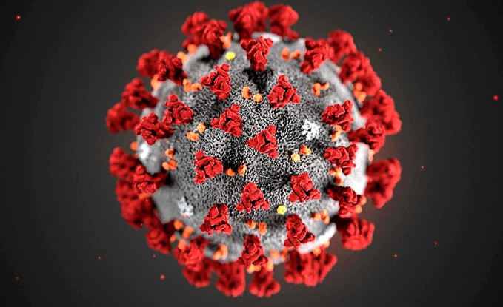
Percentage of NHs with an established/documented safe visitor policy. Percentage of NHs with an established/documented cohorting plan. Percentage of NHs that participate in Learning and Action Networks related to COVID prevention or immunization. Percentage of NHs with a QIN-QIO reviewed public health emergency preparedness plan.
COVID Bundle for Infection Control
Notes:
100% of success in WYO NH’s with these measurments

Slide 24
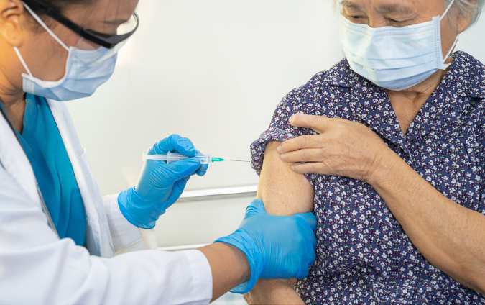
Immunizations
Increase Influenza vaccination rates by 10%.
Increase Pneumococcal vaccination rates by 10%.
Increase COVID resident “up to date” vaccination rate by 20%.
Increase COVID staff “up to date” vaccination rate by 20%.

Slide 25
Metric 6.1: Influenza Immunizations among NH Residents
The entire nation struggles with vaccine hesitancy, but Wyoming and the Intermountain West have especially high rates of vaccine hesitancy post-pandemic.

Slide 26
Metric 6.2: Pneumococcal Immunizations among NH Residents
Vaccine hesitancy

Slide 27
% of NH’s that have at least 75% of management and staff that completed a CMS approved Infection Control and Prevention training. % of NHs management and staff completed CMS approved Infection Control and Prevention Training, QSEP, Relias, Project Firstline, HealthStream or Healthcare Academy.
Training

Slide 28
Targeted Response – Quality Improvement Initiatives
Hot spot referrals for Wyoming: 60 since April 2020. Some of these NHs have been referred multiple times.
Vaccine Referrals: 25 since November 2023.

Slide 29
Wyoming Road Show
22 onsite nursing visits
Thank you to all who welcomed us to your homes and participated in data deep dives, sharing of best practices and the great work you are doing!

Slide 30
What is on the horizon?
Mid - July 2024: Expect CMS to release request for proposal for new QIN-QIO contract
November 2024: QIN-QIOs are awarded new work
November 2024: Current CMS QIN-QIO contract ends

Slide 31
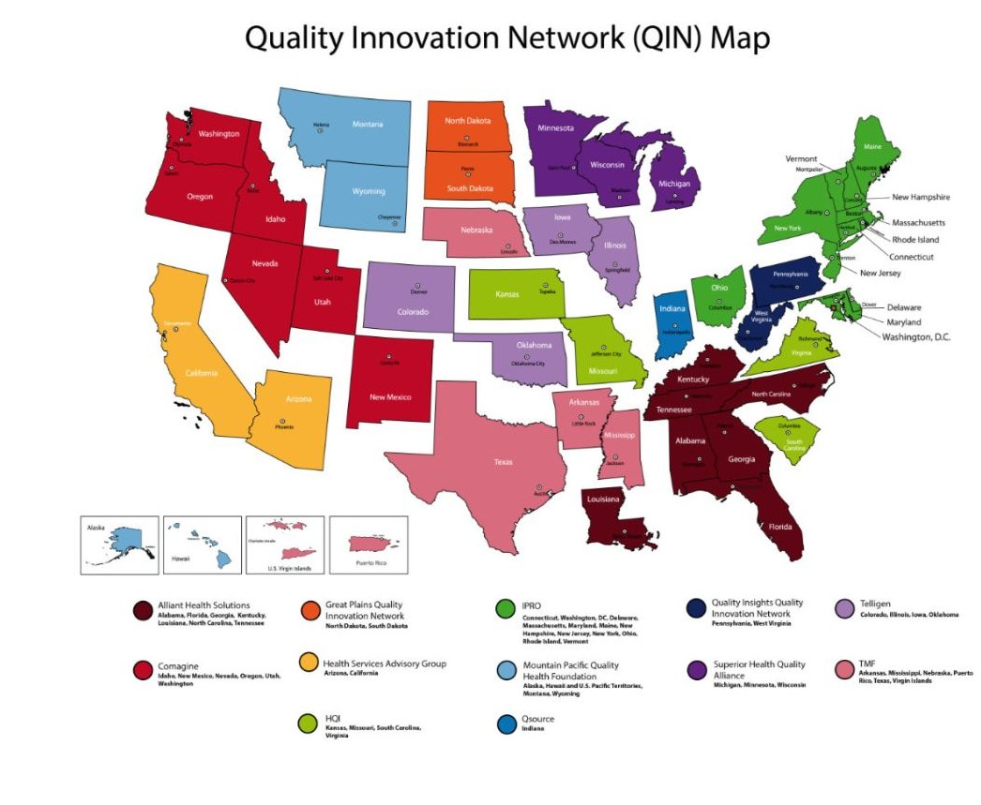
National Map of Current QIN-QIOs

Slide 32
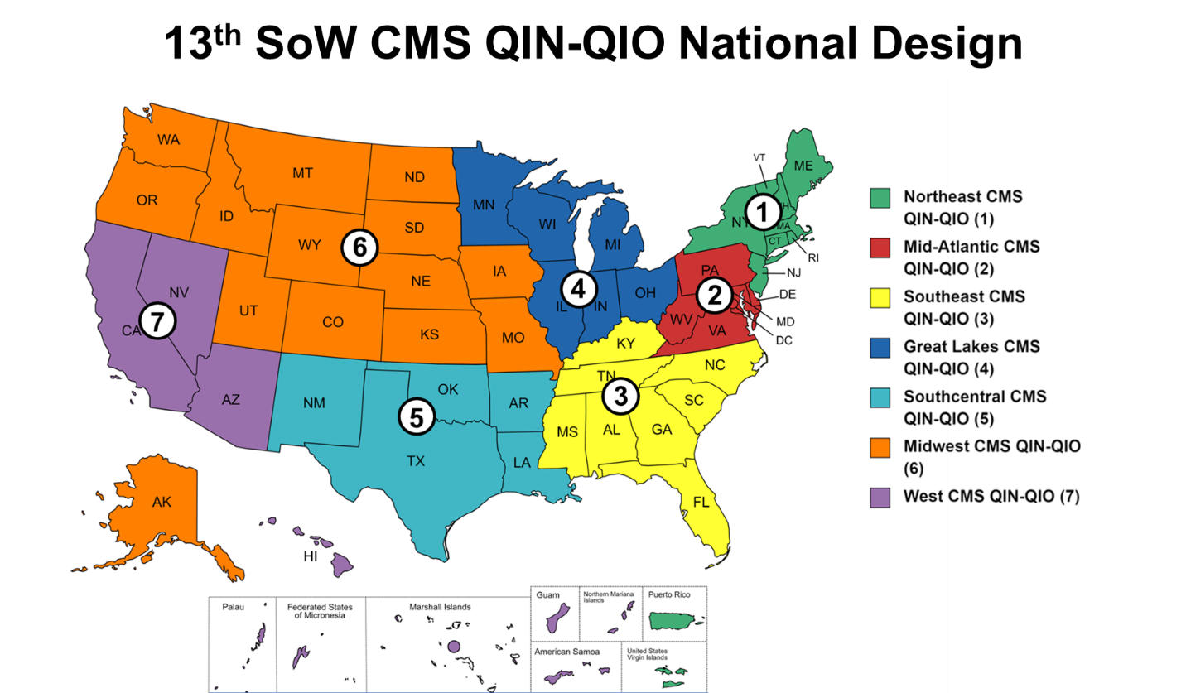
CMS Proposed Map of QIN-QIO Regions

Slide 33
This is a DRAFT and is subject to change.

Slide 34
Wyoming Culture Change:
Five-year contract funded by the Civil Money Penalties, ending March 2024.
Five participating Wyoming NHs.

Slide 35
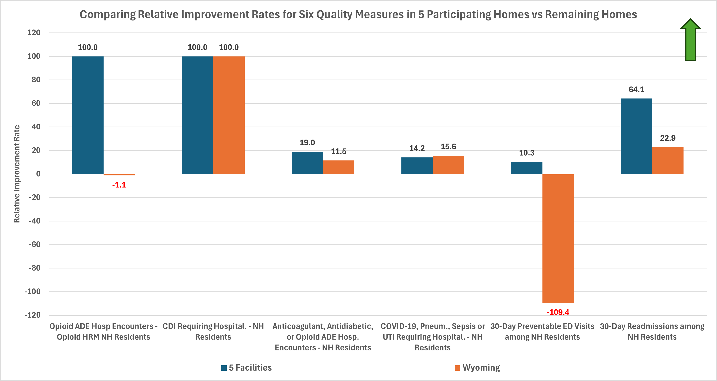
Wyoming Culture Change - Results
Baseline is 10/2018-09/2020
Remeasure most recent 12 measurement periods
RIR is Relative Improvement Rate baseline to current (year ending June 2023)
RIR is the rate that each measure was lowered from baseline to current. For these measures, the goal is for the rates to decrease, the more they decrease, the higher the RIR.

Slide 36
Questions?
Notes:
-
-

Slide 37
Thank you!
This material was prepared by Mountain Pacific, a Medicare Quality Innovation Network-Quality Improvement Organization (QIN-QIO), under contract with the Centers for Medicare & Medicaid Services (CMS), an agency of the U.S. Department of Health and Human Services (HHS). Views expressed in this material do not necessarily reflect the official views or policy of CMS or HHS, and any reference to a specific product or entity herein does not constitute endorsement of that product or entity by CMS or HHS 12SOW-MPQHF-AS-NH-5/24-416

